Slide 1
UNIT 3
Requirements Determination

Slide 2
3.1 Requirements Determination
Techniques for gathering requirements: Interviews, Joint Application Development (JAD), document analysis, and observation.
Developing the requirements definition statement.
3.2 Use Case Analysis
Identifying use cases and creating use case diagrams.
Use cases as tools for capturing functional requirements, testing, and design

Slide 3
Requirements determination
Requirements determination is the process of studying an existing system to identify its requirements, how it works, and where improvements are needed.
It's a key part of system analysis and project management, and is a crucial phase in the software development life cycle (SDLC)
Here are some steps in the requirements gathering process:
Identify stakeholders: Identify all parties involved in the project, including users, sponsors, and team members.
Set goals: Establish the project's goals and objectives.
Elicit requirements: Collect detailed information from stakeholders about what they need from the project. This can be done through interviews, surveys, and other techniques.
Document requirements: Record the requirements that have been gathered.
Confirm requirements: Confirm the requirements that have been gathered.
Prioritize requirements: Prioritize the requirements that have been gathered

Slide 4
What is requirement gathering?
Requirement gathering is the act of generating a list of requirements to define what a project is about and its goal.
You can gather insights from the stakeholders, whether they are clients, employee users, consumers or vendors.
Requirement gathering often acts as the blueprints of a project.
Poorly established requirements can have a negative impact, while properly established ones can lead to success.
Most often there are two types of requirements:
Functional: These requirements are the processes, information and interactions that the client wants built and includes how the system and its environment interact.
Non functional: These requirements are about operational and technical aspects, like encryption, security, disaster recovery, hosting and business continuity.

Slide 5
One-on-one interview
Introduce yourself and summarize the project, including its scope and any timelines.
Build report with the person you're interviewing to gain their buy-in so they are more likely to give you good input.
Let them know the overall topics you plan to discuss in your interview gathering session.
Consider asking things like, "What is your most important business process," or "What systems do you use, how do they work and are you satisfied with them?"
Be prepared with predetermined questions.
Here are some other tips to keep in mind for conducting productive interviews:
Ask open-ended questions:
To get the most of your interview time, ask questions that require more than a yes or no answer. It helps get honest and insightful answers without guiding the interview subject.
For example, "How do you calculate the monthly bonuses for sales when there is an economic downturn?"
Pinpoint details or rephrase to gain overall insight:
People answer questions differently and it is up to you to adjust.
If they focus on minimal details that don't affect your overall goal, guide them back to topics that do.
Conversely, if someone gives too general of information, ask more prodding questions that force them to think about details.

Slide 6
Interview the right people:
Make sure you interview the right stakeholders who can give you relevant and insightful information.
For example, if you need to explore how a software system works, interviewing the manager who doesn't use the program may not be the best choice, whereas the analyst team who uses it daily is.
Share the questions ahead of time:
This is a respectful gesture and also helps the interviewee best prepare their answers, which benefits the team and project while saving time in the actual interview.
Closed-ended questions can be helpful to gain information in a short amount of time or to get details that open-ended questions are unnecessary for, like "How many online orders do customers place every day," for example.

Slide 7
Group interview
Group interviews work best with interviewees of the same job position or level, as they are familiar with the topics at hand and what areas of opportunity exist.
Having a time constraint also generates more urgent information sharing, like scheduling the session for only one hour versus two.
Because people justify their viewpoints with supporting evidence in front of others, you can often gain deeper insights than on a one-on-one interview.
Discussing each topic in a group setting also allows you to refine and clarify the requirement, which can lead to better outcomes and understanding useful to the project.
Scheduling group interviews is one challenge, since finding a time that works well for many people requires effort.

Slide 8
Survey
Offering a survey or questionnaire allows you to collect information from many people in a relatively short amount of time, particularly helpful for interacting with people in different geographic locations and also good for budget savings and time constraints.
When preparing your survey, consider these tips: Keep them shorter versus longer so people are more likely to complete them
Focus on a feature or topic, rather than many at once
Use ratings to generate data analysis responses, like "strongly agree," "agree" or "disagree"
Have some open-ended questions to allow free-form responses to get detailed input
Use the six question words to structure your survey: who, what, when, where, why and how, like "How does the user login," or "Where are the results shown in the program?"

Slide 9
User observation
User observation is a bit like job shadow research.
You spend time with a person or group of people to see how they perform their tasks in a real-life job setting.
It can help you address the requirements specifically with the people in mind who will benefit from them.
Some things to keep in mind when conducting user observation: Construct a visual of the end-to-end process a person follows to do their job daily
Be mindful when asking questions to not disrupt seeing a natural work environment
Observe, take notes, remain unbiased and keep from making judgments
Gather any documentation that helps you find out procedures, like a user training manual
Observe well enough to understand fully what a platform, software or device is capable of
User observation is also helpful to improve a task by validating previously recorded data. Be sure to thank those who let you spend time with them. It helps build rapport and is useful if you need to observe again or connect with them for follow-up questions.

Slide 10
Document analysis
Document analysis includes reviewing the existing system's documentation, like user manuals and instructions.
It is helpful particularly for any changeover risk mitigation and you can glean important information that pushes the boundary of establishing new requirements or validating existing ones.
It is helpful to have multiple people review the documents and hold a meeting afterwards to compile your insights to make sure nothing gets missed.

Slide 11
Joint Application Development (JAD) is a collaborative methodology used in systems development to involve stakeholders, business users, and IT professionals in the design and development of a system.
The goal of JAD is to improve the efficiency and effectiveness of the development process by fostering direct communication and consensus among the participants.
Key Features of JAD:
Collaborative Workshops: Brings together stakeholders, end-users, and developers in structured sessions to identify requirements, clarify objectives, and design solutions.
Facilitator-Driven: A neutral facilitator guides the sessions to ensure productive discussions and to keep the team focused on goals.
Rapid Feedback: Decisions and requirements are finalized quickly with all relevant parties present.
User Involvement: Users are actively engaged, ensuring the system meets their needs and expectations.

Slide 12
Steps in JAD:
Preparation:
Define the project scope.
Select participants, including business users, IT staff, and decision-makers.
Prepare materials and agenda.
JAD Sessions:
Conduct workshops to gather requirements, discuss challenges, and brainstorm solutions.
Use visual aids (e.g., diagrams, prototypes) for better understanding.
Documentation:
Record all decisions, requirements, and action plans.
Develop documentation for reference and further development.
Review and Follow-Up:
Share outcomes with participants.
Validate requirements to ensure consensus.

Slide 13
Benefits of JAD:
Enhanced Communication: Encourages direct interaction between stakeholders and developers.
Faster Development: Reduces misunderstandings and the need for rework by clarifying requirements upfront.
Better Quality Systems: Involves users in the design process, ensuring the system aligns with their needs.
Cost-Effectiveness: Saves time and resources by addressing issues early.
Limitations of JAD:
Resource Intensive: Requires significant time and commitment from participants.
Facilitator Dependency: Success depends on the skill of the facilitator.
Potential for Conflict: Differences in opinions among stakeholders may arise.
JAD is especially useful for complex projects with diverse user groups or when requirements are not well-defined initially.
It aligns well with methodologies like Agile and can complement traditional systems development life cycle (SDLC) approaches.

Slide 14
what is a use case diagram?
A UML(Unified Modeling Language) use case diagram is the primary form of system/software requirements for a new software program underdeveloped.
Use cases specify the expected behavior (what), and not the exact method of making it happen (how).
Use cases once specified can be denoted both textual and visual representation (i.e. use case diagram).
A key concept of use case modeling is that it helps us design a system from the end user's perspective.
It is an effective technique for communicating system behavior in the user's terms by specifying all externally visible system behavior.

Slide 15
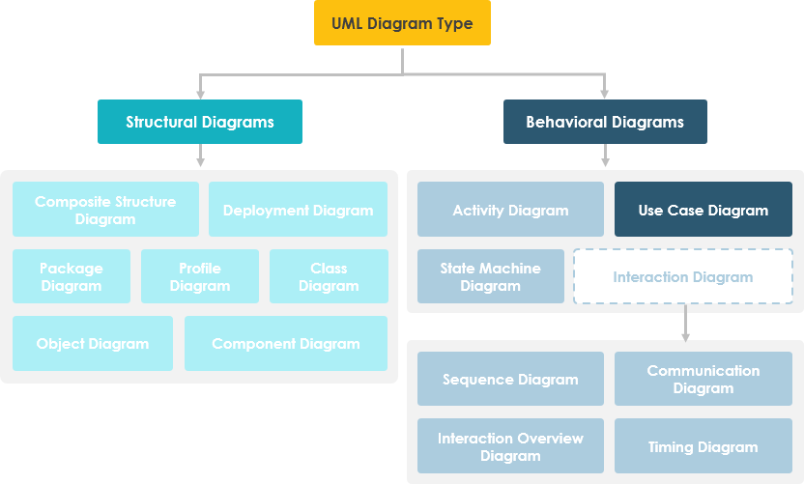
A use case diagram is usually simple. It does not show the detail of the use cases:
It only summarizes some of the relationships between use cases, actors, and systems.
It does not show the order in which steps are performed to achieve the goals of each use case.

Slide 16
Origin of Use Case
These days use case modeling is often associated with UML, although it has been introduced before UML existed.
Its brief history is as follow:
In 1986, Ivar Jacobson first formulated textual and visual modeling techniques for specifying use cases.
In 1992 his co-authored book Object-Oriented Software Engineering - A Use Case Driven Approach helped to popularize the technique for capturing functional requirements, especially in software development.

Slide 17
Purpose of Use Case Diagram
Use case diagrams are typically developed in the early stage of development and people often apply use case modeling for the following purposes:
Specify the context of a system
Capture the requirements of a system
Validate a systems architecture
Drive implementation and generate test cases
Developed by analysts together with domain experts

Slide 18
Actor
Someone interacts with use case (system function).
Named by noun.
Actor plays a role in the business
Similar to the concept of user, but a user can play different roles
For example:
A prof. can be instructor and also researcher
plays 2 roles with two systems
Actor triggers use case(s).
Actor has a responsibility toward the system (inputs), and Actor has expectations from the system (outputs).

Slide 19

Use Case
System function (process - automated or manual)
Named by verb + Noun (or Noun Phrase).
i.e. Do something
Each Actor must be linked to a use case, while some use cases may not be linked to actors.

Slide 20
Communication Link
The participation of an actor in a use case is shown by connecting an actor to a use case by a solid link.
Actors may be connected to use cases by associations, indicating that the actor and the use case communicate with one another using messages.

Slide 21
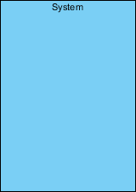
Boundary of system
The system boundary is potentially the entire system as defined in the requirements document.
For large and complex systems, each module may be the system boundary.
For example, for an ERP system for an organization, each of the modules such as personnel, payroll, accounting, etc.
can form a system boundary for use cases specific to each of these business functions.
The entire system can span all of these modules depicting the overall system boundary

Slide 22


Use Case Relationship
Extends
Indicates that an "Invalid Password" use case may include (subject to specified in the extension) the behavior specified by base use case "Login Account".
Depict with a directed arrow having a dotted line. The tip of arrowhead points to the base use case and the child use case is connected at the base of the arrow.
The stereotype "<<extends>>" identifies as an extend relationship

Slide 23

Include
When a use case is depicted as using the functionality of another use case, the relationship between the use cases is named as include or uses relationship.
A use case includes the functionality described in another use case as a part of its business process flow.
A uses relationship from base use case to child use case indicates that an instance of the base use case will include the behavior as specified in the child use case.
An include relationship is depicted with a directed arrow having a dotted line. The tip of arrowhead points to the child use case and the parent use case connected at the base of the arrow.
The stereotype "<<include>>" identifies the relationship as an include relationship.

Slide 24
Generalization
A generalization relationship is a parent-child relationship between use cases.
The child use case is an enhancement of the parent use case.
Generalization is shown as a directed arrow with a triangle arrowhead.
The child use case is connected at the base of the arrow. The tip of the arrow is connected to the parent use case.

Slide 25
Use cases are a valuable tool for capturing functional requirements, testing, and design because they help to:
Identify functional requirements
Use cases describe how users interact with a system, which helps to identify and clarify the system's functional requirements and behaviors.
Communicate between stakeholders
Use cases can help with communication between stakeholders.
Visualize functional requirements
Use case diagrams are a type of Unified Modeling Language (UML) diagram that can help visualize a system's functional requirements.
Identify factors that may influence the system
Use case diagrams can help identify internal or external factors that may influence the system.
Serve as a foundation for design and implementation
Use cases can serve as a foundation for designing and implementing a system.

Slide 26
Here are some tips for writing good functional requirements: Use modal verbs consistently, Tag each requirement with a unique identifier, Write only one requirement in each statement, Write concisely, and Make sure each requirement is testable.
Here are some steps you can take to write a use case:
Describe the system
Identify the actors
Define the actors' goals
Create a scenario
Consider alternate flows
Repeat steps 2–5 to compile the use case

